Slide 1
SUBJECT :-
“DATA SCIENCE”

Slide 2
PROJECT :-
“AIR QUALITY CHECK”

Slide 3
SUBMITTED BY: SUBMITTED TO:
ANKIT YADAV MS. VASUDHA
11707994 ( 23636)
KM094

Slide 4
INTRODUCTION:-
Data science is a multi-disciplinary field that uses scientific methods, processes, algorithms and systems to extract knowledge and insights from structured and unstructured data. Data science is the same concept as data mining and big data: "use the most powerful hardware, the most powerful programming systems, and the most efficient algorithms to solve problems

Slide 5
". Data science is a "concept to unify statistics, data analysis, machine learning and their related methods" in order to "understand and analyze actual phenomena" with data. It employs techniques and theories drawn from many fields within the context of mathematics, statistics, computer science, and information science. Turing award winner Jim Gray imagined data science as a "fourth paradigm" of science (empirical, theoretical, computational and now data-driven) and asserted that "everything about science is changing because of the impact of information technology" and the data deluge.

Slide 6
In 2015, the American Statistical Association identified database management, statistics and machine learning, and distributed and parallel systems as the three emerging foundational professional communities.

Slide 7
Various Method used in this analysis are as follows:-
Data Cleaning using Tableau Prep
Data validation
Slicing
Pivot Table
Pivot Chart
Visualization
Dashboard

Slide 8
Hyperlinking
Logical Operations
Cell formatting
Text formatting
Functional operation
Data handling etc.

Slide 9
TABLEAU:-
Tableau Software is an American interactive data visualization software company founded in January 2003 by Christian Chabot, Pat Hanrahan and Chris Stolte, in Mountain View, California. The company is currently headquartered in Seattle, Washington, United States ]focused on business intelligence. On August 1, 2019, Salesforce.com acquired Tableau.

Slide 10
DATA CLEANING:-
Data cleansing or data cleaning is the process of detecting and correcting (or removing) corrupt or inaccurate records from a record set, table, or database and refers to identifying incomplete, incorrect, inaccurate or irrelevant parts of the data and then replacing, modifying, or deleting the dirty or coarse data. Data cleansing may be performed interactively with data wrangling tools, or as batch processing through scripting.

Slide 11
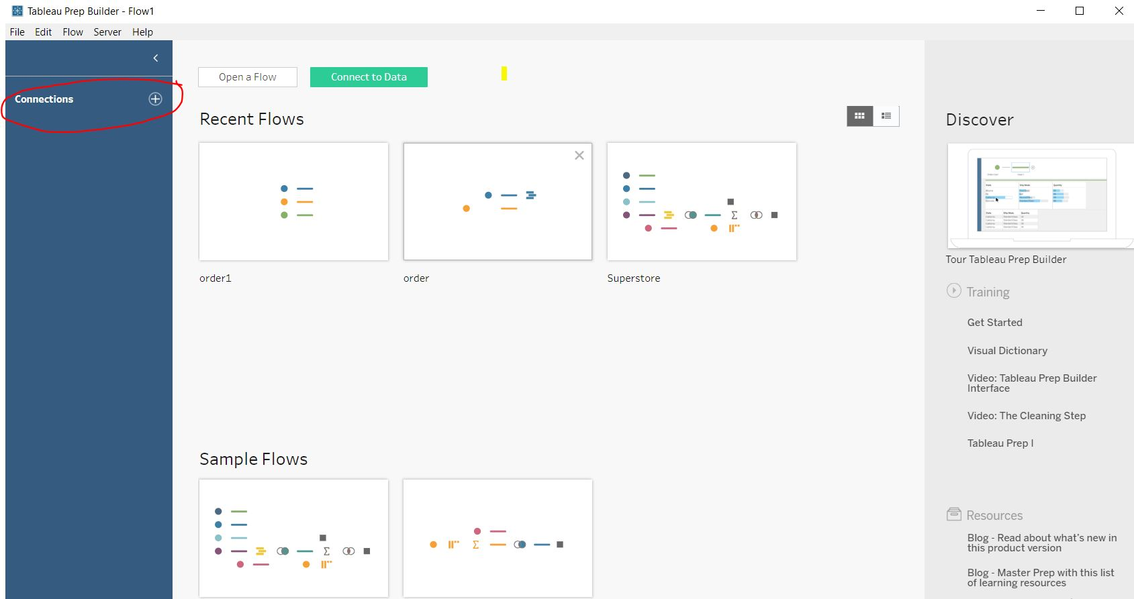
GLIMPSE OF ANALYSIS:-

Slide 12
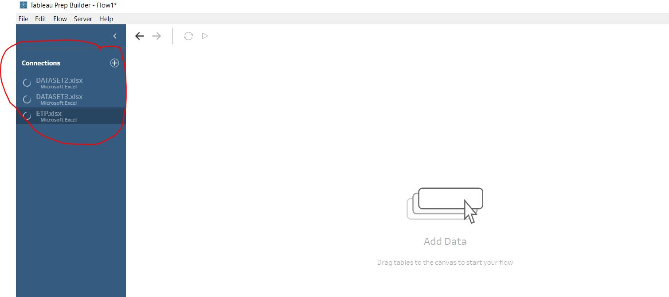
IMPORTING DATA SET:-

Slide 13
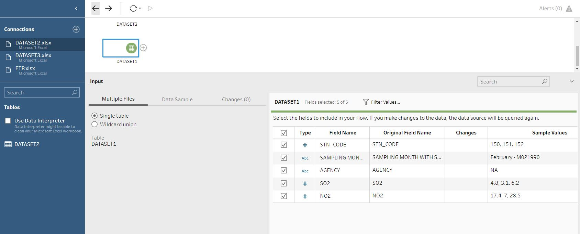

Slide 14
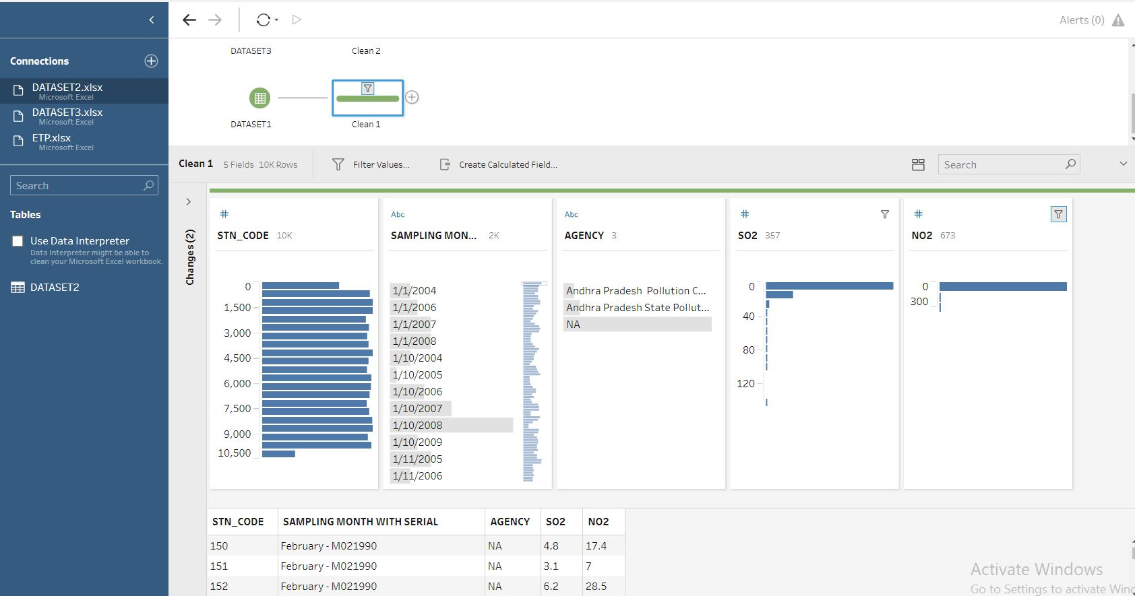
PROCESS OF DATA CLEANING:-

Slide 15
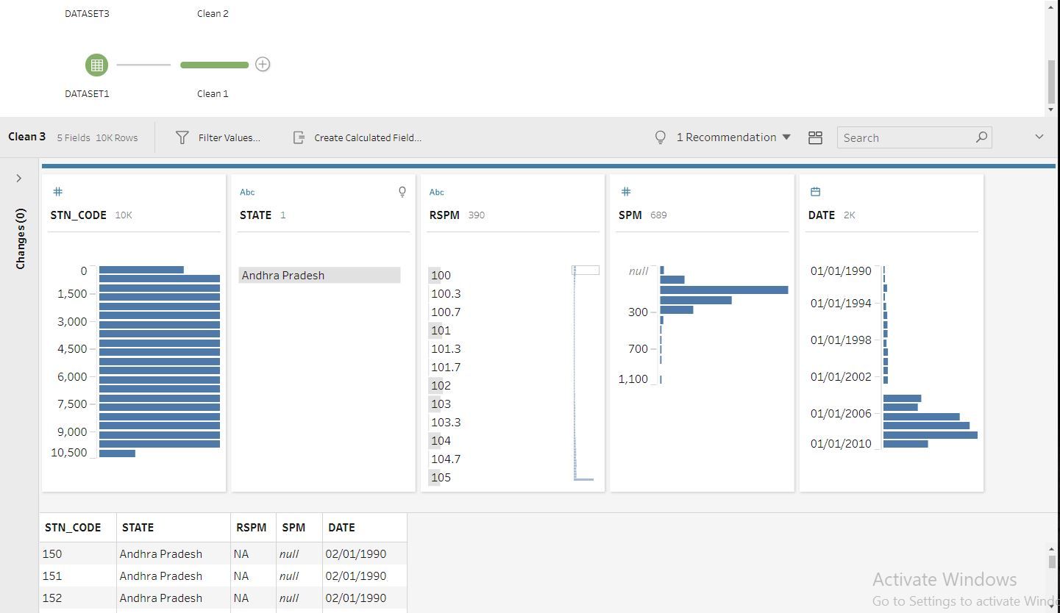

Slide 16
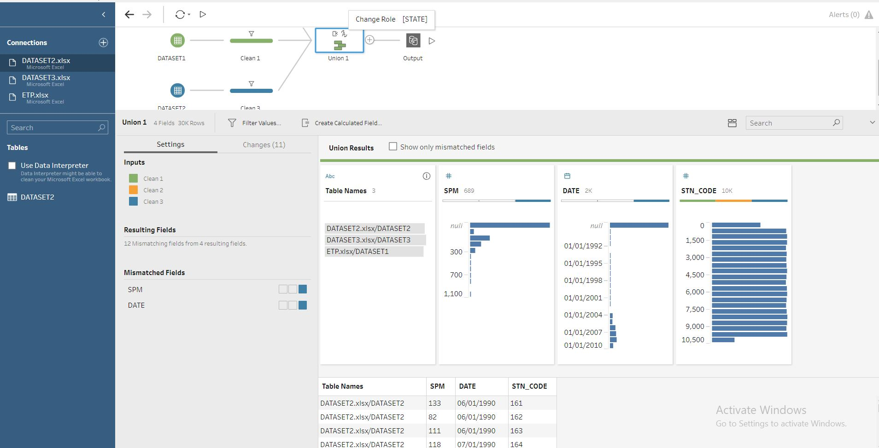
APPLYING UNION:-

Slide 17
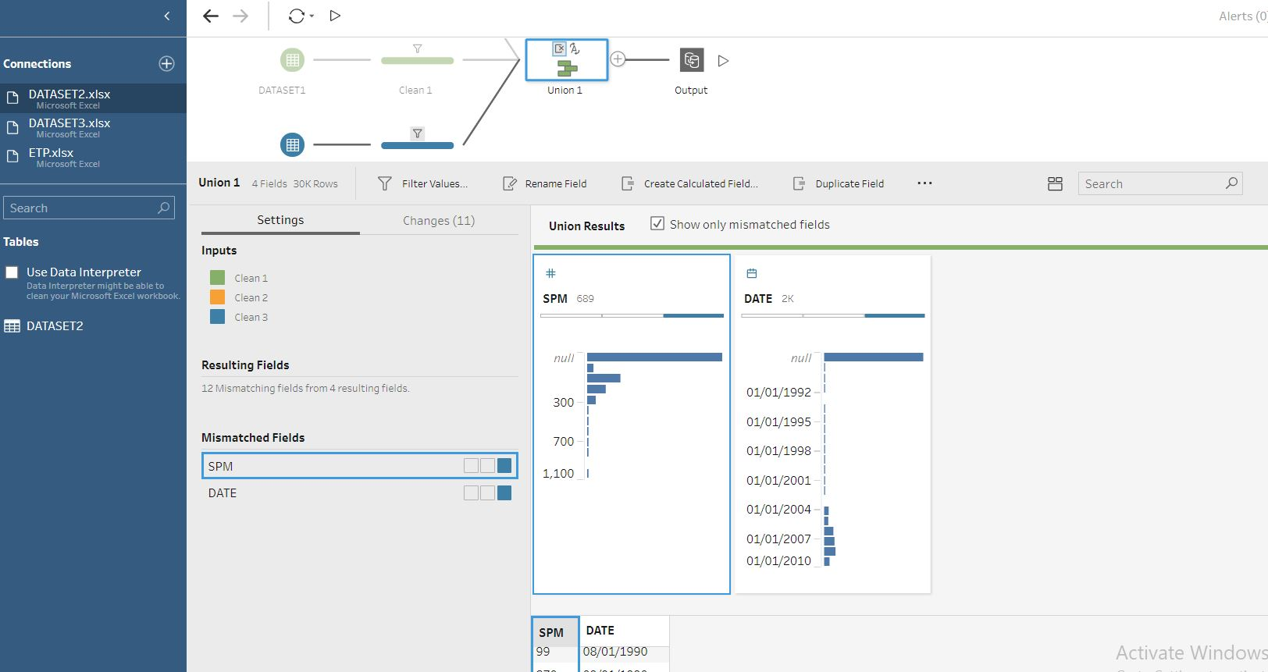
TAKING OUTPUT:-

Slide 18
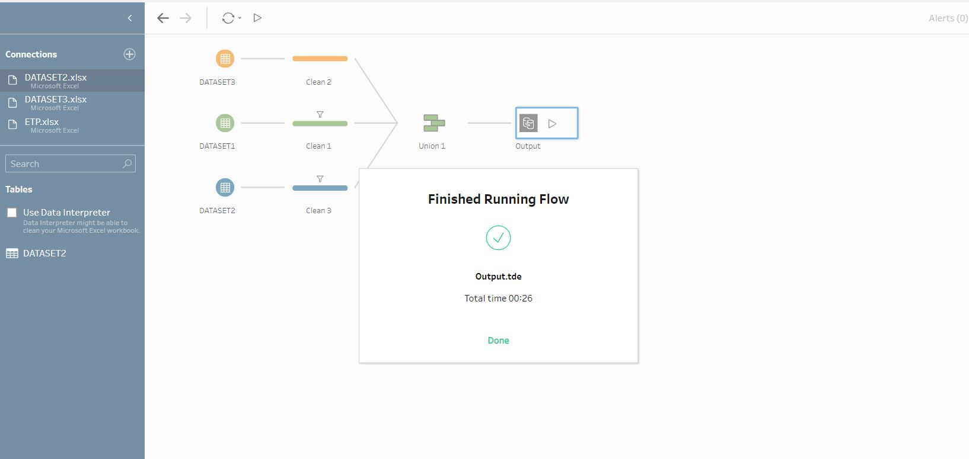
FINAL RUN:-

Slide 19
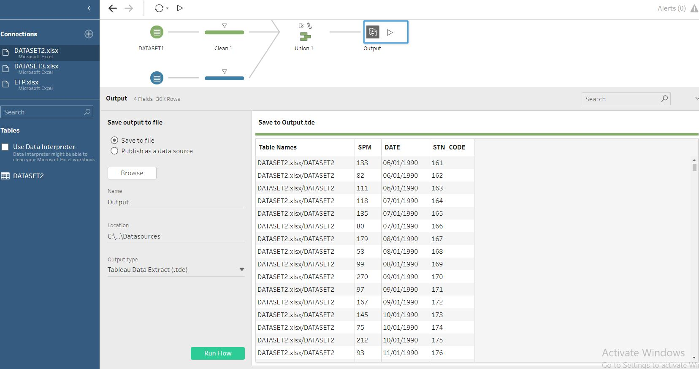
DATA OF THE OUTPUT:-

Slide 20
DATA VISUALISATION USING THE EXCEL:-
INTRO :-
Microsoft Excel is a spreadsheet developed by Microsoft for Windows, macOS, Android and iOS. It features calculation, graphing tools, pivot tables, and a macro programming language called Visual Basic for Applications. It has been a very widely applied spreadsheet for these platforms, especially since version 5 in 1993, and it has replaced Lotus 1-2-3 as the industry standard for spreadsheets. Excel forms part of the Microsoft Office suite of software.

Slide 21
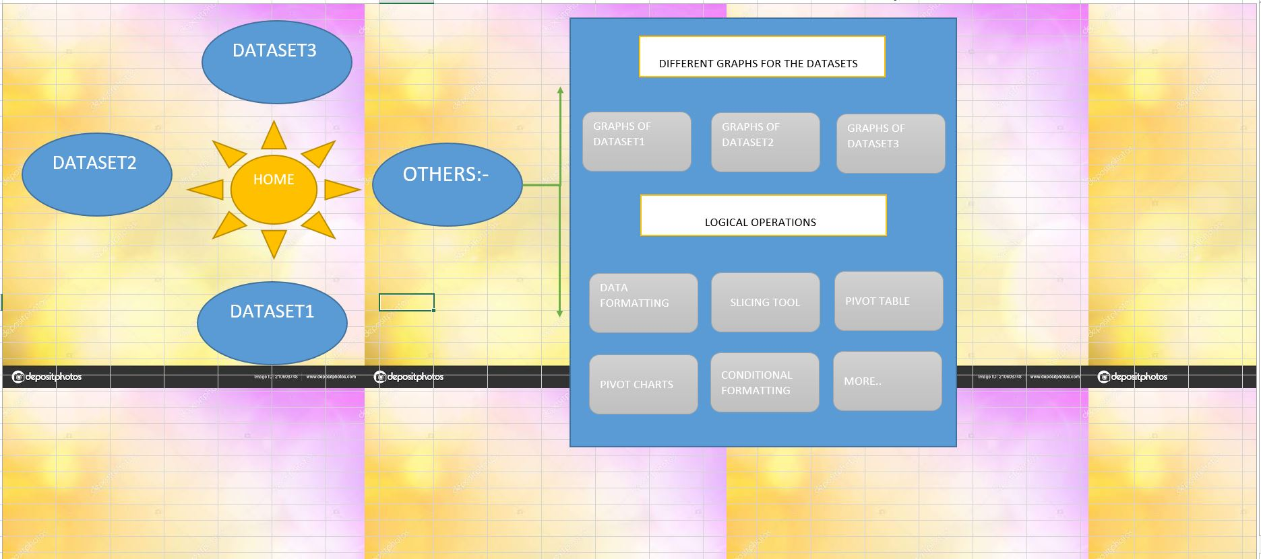
DASH BOARD:-

Slide 22
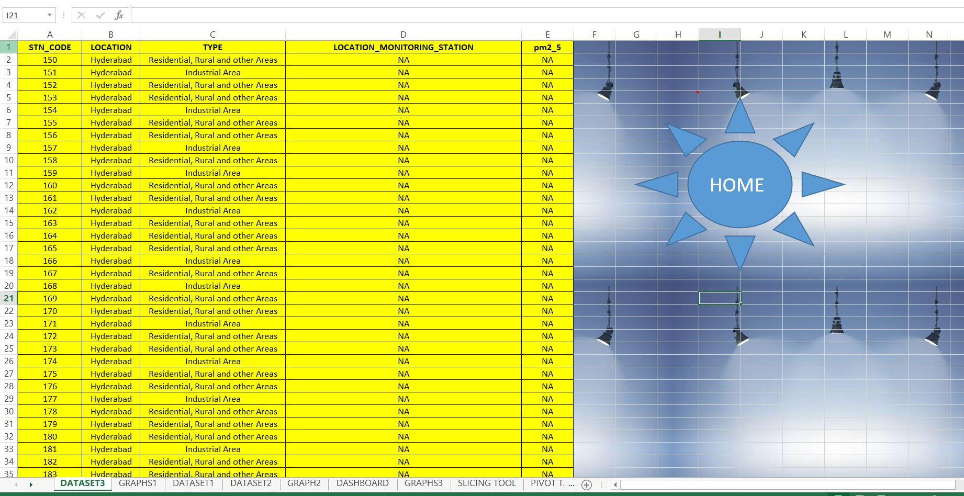
DATA SET 1:-

Slide 23
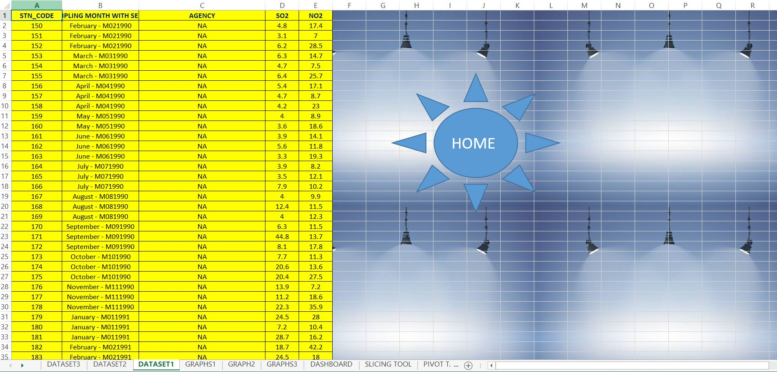
DATA SET 2:-

Slide 24
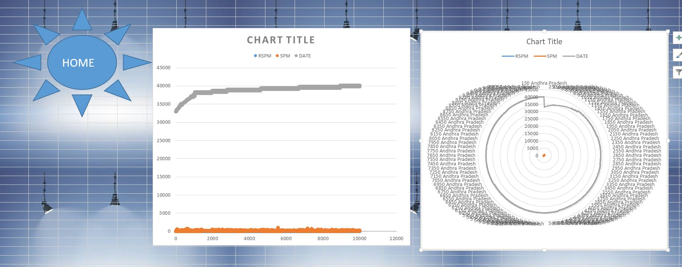
SOME OF THE CHARTS:-

Slide 25
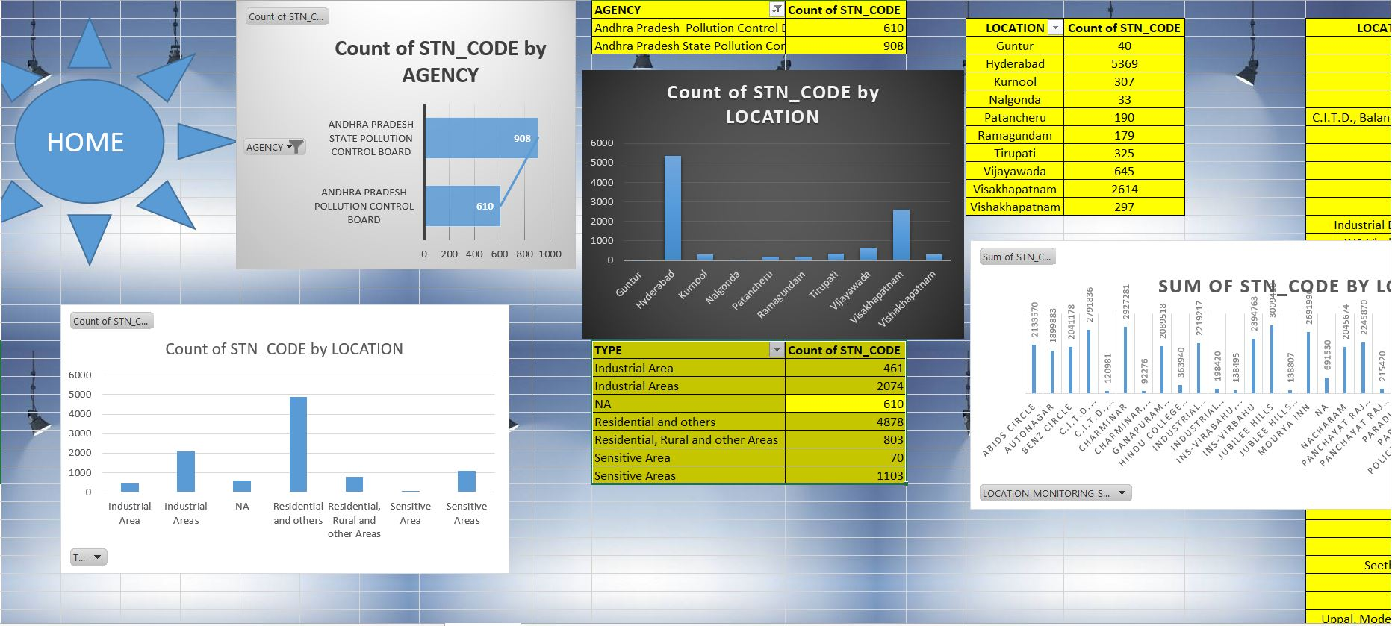
GRAPHS:-

Slide 26
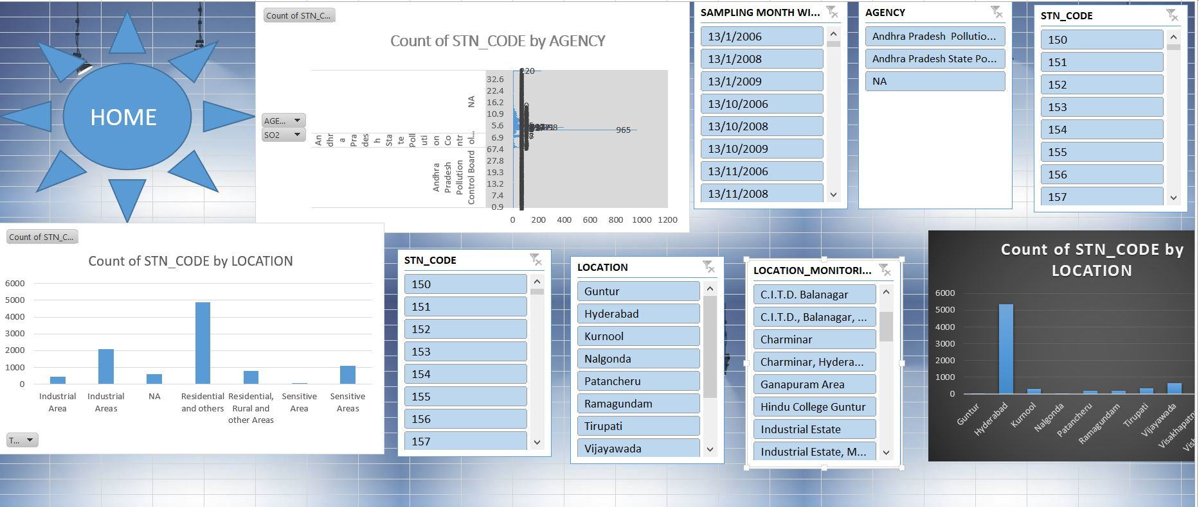
SLICERS:-

Slide 27
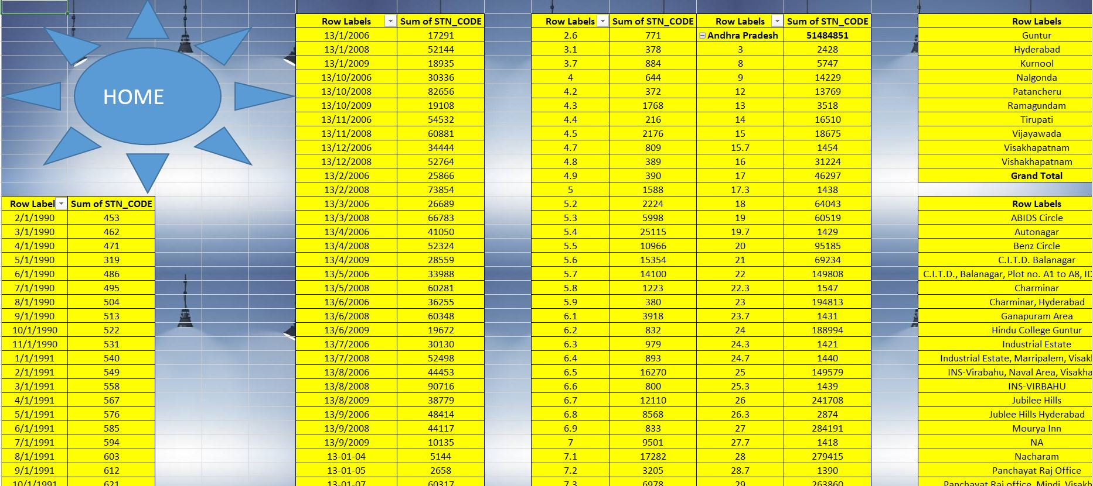
TABLES:-

Slide 28
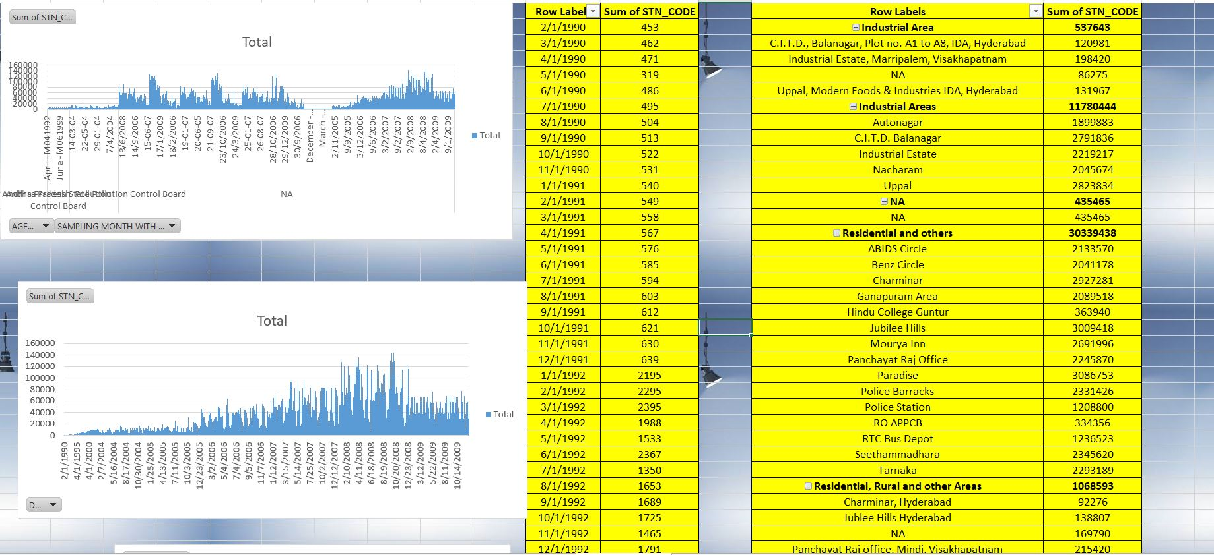

Slide 29
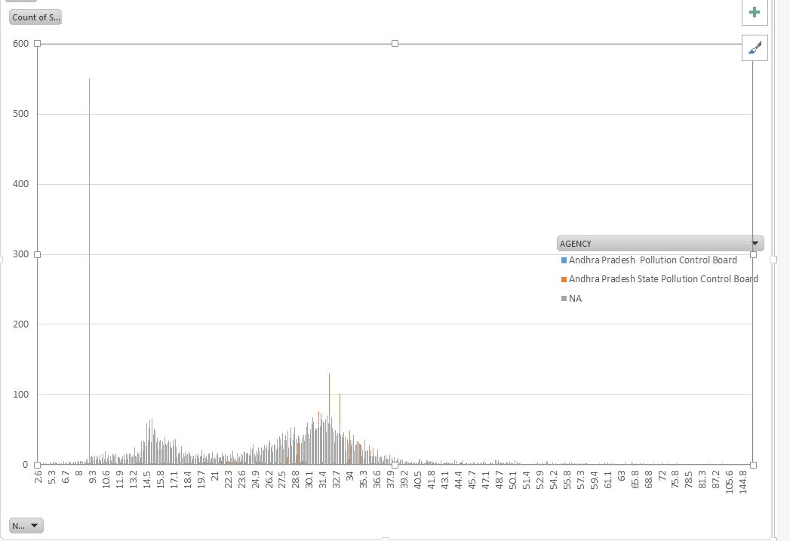
MORE CHARTS:-

Slide 30
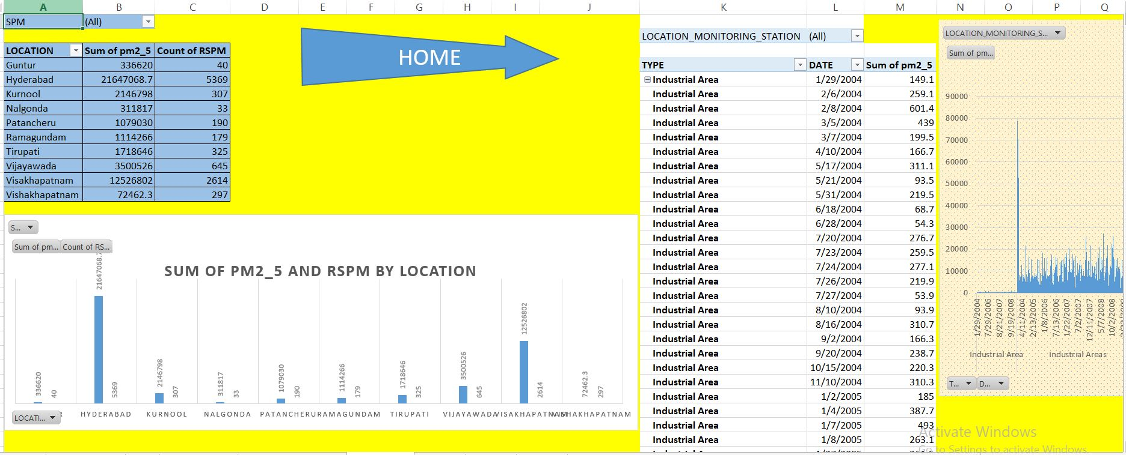

Slide 31
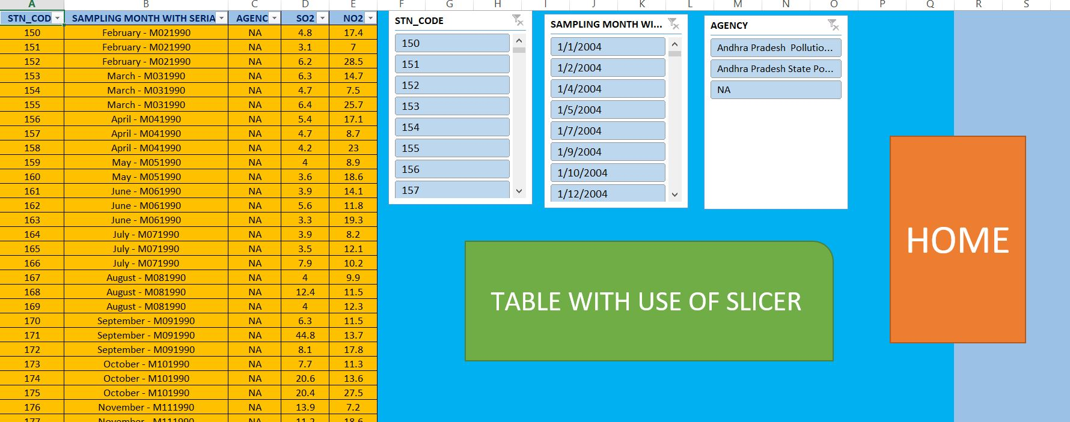

Slide 32
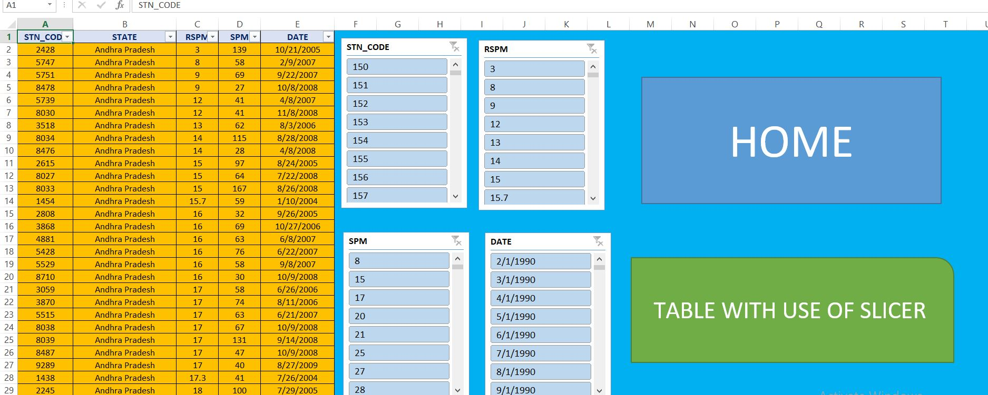

Slide 33
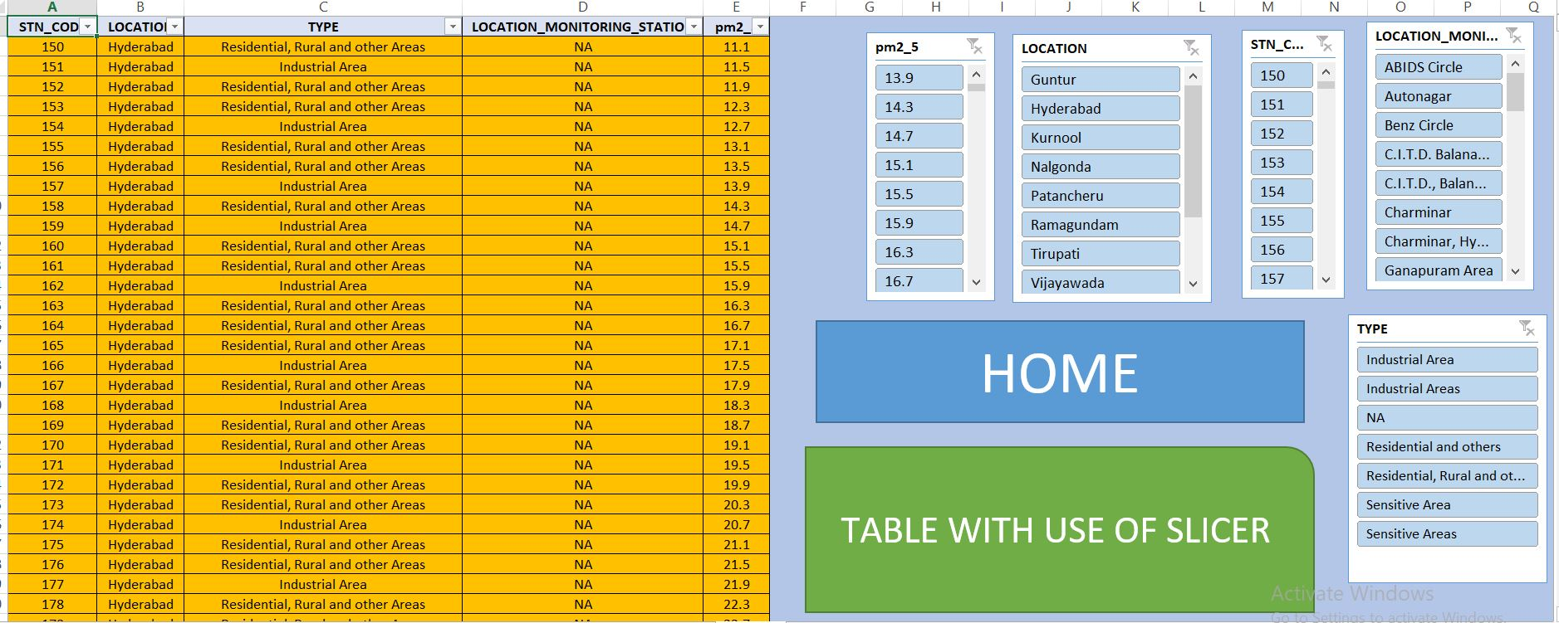

Slide 34
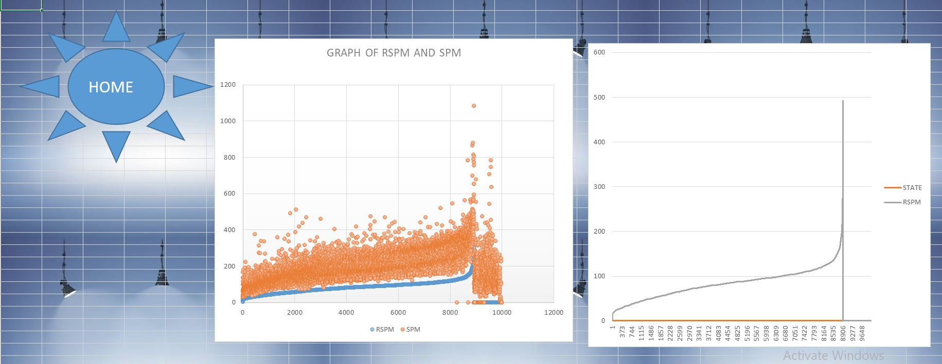

Slide 35
CONCLUSION:-
BY THE ANALYSIS OF THIS DATASET WE CAN PREDICT THE AIR QUALITY OF DIFFERENT AREA IN ANDRAPRADESH.
IT PREDICT VALUES OF THE SO2 AND PPM.
BY THIS WE CAN IMPLEMENT MEASURES TO PREVENT MORE INCREASE IN THE BAD PROPORATION OF THE AIR.

